Slide 1



Program Feedback
Project Short Summary
The project clearly outlines the goal of using data analytics and machine learning for real-time house price prediction. While the success of the Gradient Boosting Regressor is mentioned, including details about the data used, exploring other algorithms for comparison, and providing specific performance metrics (like MAPE value) would strengthen the impact. Additionally, mentioning any challenges faced and how future improvements address limitations (like incorporating more data) would provide a more well-rounded picture of the project
This Bitcoin price prediction project aims to analyze historical data, select relevant features, and train models (e.g., ARIMA, LSTM) to forecast future Bitcoin prices, evaluating performance and discussing implications for investors and traders.
Vallem Gopi
23505a4205@pvpsit.ac.in
Prasad V. Potluri Siddhartha Institute of Technology
#skillsbuild

Slide 2
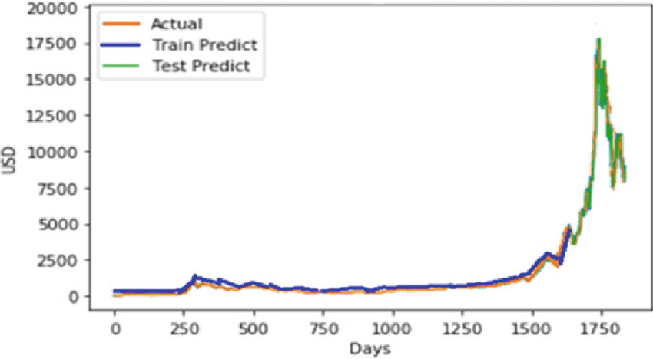
Final Project Outcome Screenshot

Slide 3
